Slide 1

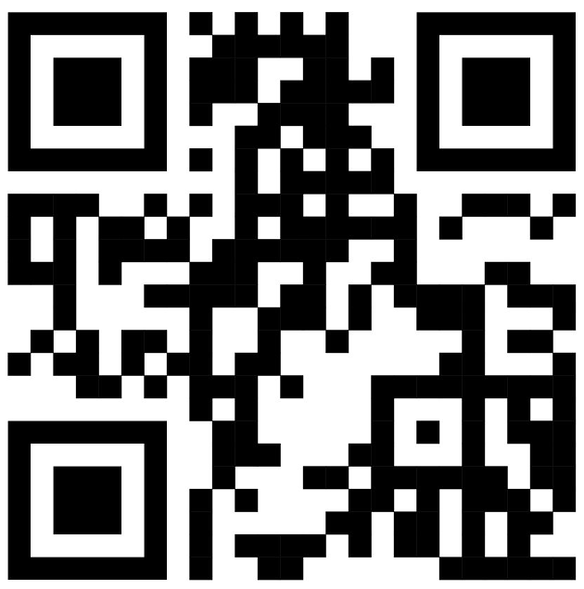
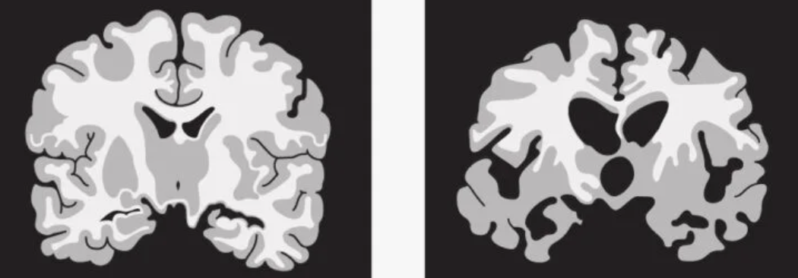
Beyond Memory: Creative Cognitive Strategies for Dementia Support
Prim Prasertsri
Department of Psychology | Pacific University | 2043 College Way | Forest Grove, OR 97116
Alzheimer’s Dementia
Nearly 6.5 million Americans aged 65 or older live with dementia, a global term used to describe cognitive decline (i.e., memory loss, communication problems, planning difficulties) and motor decline due to brain tissue damage (Alzheimer’s Association, 2023). Dementia can develop due to the aging process, but the onset can also occur from stroke, traumatic brain injury, infection, substance abuse, or nutritional deficiencies. Early signs of dementia can include confusion with time and space orientation, trouble completing familiar tasks, forgetting recently learned information, and decreased judgement when completing tasks. As dementia progresses, personality and behavioral changes may start to occur (i.e., withdrawal, anxiety, depression, aggression). In the late stages of dementia, cognitive and motor decline is usually severe and impacts the person with dementia’s ability to complete tasks independently (Alzheimer’s Association, 2023). While dementia is a non-reversible and non-curable condition, there are possible cognitive, physical, and pharmacological interventions that can maintain motor and cognitive function for as long as possible.
Alzheimer’s Dementia (AD) is the most common type of dementia, accounting for around 80% of all dementia diagnoses (Alzheimer’s Association, 2023). The key characteristic that differentiates AD from other forms is the presence of amyloid-beta plaques and neurofibrillary tangles. Amyloid-beta plaques are composed of amyloid-beta 40 and amyloid-beta 42 proteins (Zou et al., 2014). While the mechanisms of amyloid-beta proteins are still unsure, it is suggested that these proteins have antimicrobial properties in a brain without dementia (Brothers et al., 2018). The production and recycling of amyloid-beta proteins is disrupted due to tissue damage in people with AD. Higher concentrations of amyloid-beta proteins create a higher likelihood of forming toxic amyloid-beta plaques which reside in the spaces between neurons (Zou et al., 2014). As these plaques continue to accumulate in the brain, they cause neurodegeneration that leads to cognitive and motor decline.
Normal Brain Diseased Brain
Source; Medical News Today
            Thesis Question
To what extent can cognitive strategies like meditation and visual imagery be used in the management of Alzheimer’s Dementia?
Current Interventions
Current interventions for AD include pharmaceuticals, cognitive interventions, and physical interventions. Glutamate regulators and acetylcholine inhibitors are the most commonly prescribed medications for the early stages of dementia (Mayo Clinic, 2022). These medications focus primarily on managing symptoms of cognitive decline by regulating the concentrations of excitatory neurotransmitters in the brain (Mayo Clinic, 2022). Cognitive interventions for dementia include cognitive stimulation training (CST), mindfulness based Alzheimer’s stimulation (MBAS), and cognitive behavioral therapy (CBT). The primary goal of these interventions is to reduce anxiety and depression for people with AD and maintain cognitive function (Quintana-Hernandez et al., 2022). Depression and anxiety are associated with faster cognitive decline in people with AD (Ozen et al., 2021). Finally, physical interventions prioritize motor function and independence. Physical intervention programs for people with AD that have increased their quality of life and ability to complete daily activities included environmental modifications, caretaker education and skill training, and problem solving strategies (Laver et al., 2017). A meta-analysis on AD studies completed by Aguirre et al. (2013) suggests that the most effective way to manage dementia symptoms is through a combination of physical and cognitive maintenance.
Meditation and Visual Imagery as New Strategies
Meditation and visual imagery are cognitive strategies that have been studied in the contexts of positive psychology and sports psychology respectively. Meditation is an intervention for people with dementia is still being researched. The majority of clinical studies focusing on meditation for people with AD have been published in the last decade, but the results of these studies suggest that meditation can be beneficial cognitively and physically (Hoffman et al., 2020). Meditation reduces stress and anxiety by decreasing cortisol levels in the body. Additionally, it can increase glucose and insulin metabolism in the body as well as improving blood flow in damaged areas of the brain (Singh-Khalsa, 2015). High concentrations of cortisol are associated with the onset of type II diabetes, hypertension, inflammation, depression, and physical activity (Hoffman et al., 2020). These are all risk factors associated with developing Alzheimer’s dementia as well as exacerbating the progression of dementia (Loy et al., 2013).
Visual imagery studies in sports psychology were developed based off of the psychoneuromuscular theory. The premise of this theory is that imagining one’s self completing an action will activate the same neural pathways as completing the action in reality, but to a lesser extent. Athletes who utilize visual imagery prior to completing a task have reported higher levels of self-efficacy and self-confidence (Munzert & Kruger, 2018).
In non-athletic contexts, medical students who were asked to use mental imagery prior to completing a practice surgery reported less surgical errors than the ones who were asked to reference a textbook (Munroe-Chandler & Guerrero, 2017). Visual imagery in rehabilitation programs for people recovering from strokes has been demonstrated to facilitate the motor planning process (Barreto-Monteiro et al., 2017).
Conclusions
The purpose of this review was to support meditation and visual imagery as under-researched cognitive strategies for dementia interventions. Alzheimer’s dementia is a non-curable and non-reversible disease. However, there are available motor and cognitive interventions that can address symptoms that develop due to the progression of AD. Medications for AD can slow down cognitive decline due to tissue damage, but they cannot address the onset of symptoms due to depression and anxiety. Physical interventions can help maintain motor function and reduce the risk of physical injury, while cognitive interventions can alleviate stress for the person with AD and their family. Meditation and visual imagery as AD interventions can support the goal of the person with AD to maintain independence and preserve their quality of life for as long as possible. Meditation addresses cortisol imbalances that can increase the risk of developing AD or cause faster cognitive and physical decline for someone who is already diagnosed with AD. Visual imagery has been applied to other neurological conditions for maintaining neural pathways, as well as preserving motor planning and execution abilities. Despite that, research on meditation and visual imagery for AD is still exploratory. This review proposes that meditation and visual imagery have the potential to display beneficial results for people in all stages of progression of AD. Ultimately, more studies with standardized procedures and more longitudinal studies on AD need to be published to understand the full effects of current and possible interventions on AD progression.
Select References
Aguirre, E., Hoare, Z., Streater, A., Spector, A., Woods, B., Hoe, J., & Orrell, M. (2013). Cognitive stimulation therapy (CST) for people with dementia--who benefits most?. International Journal of Geriatric Psychiatry, 28(3).
Alzheimer’s Association (2023). 2023 Alzheimer’s Disease Facts and Figures.
Barreto-Monteiro, K., Cardoso, M. D. S., Cabral, V. R. D. C., Santos, A. O. B. D., Silva, P. S. D., Castro, J. B. P., & Vale, R. G. S. (2021). Effects of motor imagery as a complementary resource on the rehabilitation of stroke patients: A Meta-Analysis of randomized trials. Journal of Stroke and Cerebrovascular Diseases, 30(8).
Brothers, H. M., Gosztyla, M. L., & Robinson, S. R. (2018). The physiological roles of Amyloid-β Peptide hint at new ways to treat Alzheimer's Disease. Frontiers in aging neuroscience, 10(118).
Hoffman, L., Hutt, R., Yi Tsui, C. K., Zorokong, K., & Marfeo, E. (2020). Meditation-based Interventions for adults With dementia: A Scoping review. The American Journal of Occupational Therapy, 74(3)
Laver, K., Cumming, R., Dyer, S., Agar, M., Anstey, K.J., Beattie, E., Brodaty, H., Broe, T., Clemson, L., Crotty, M., Dietz, M., Draper, B., Flicker, L., Friel, M., Heuzenroeder, L., Koch, S., Kurrle, S., Nay, R., Pond, D., Thompson, J., Santalucia, Y., Whitehead, C. and Yates, M. (2017), Evidence-based occupational therapy for people with dementia and their families: What clinical practice guidelines tell us and implications for practice. Australian Occupational Therapy Journal, 64.
Loy, C. T., Schofield, P. R., Turner, A. M., & Kwok, J. B. (2014). Genetics of dementia. Lancet, 383(9919)
Mayo Clinic (2022).Dementia: Symptoms and causes.
Munroe-Chandler, K., & Guerrero, M. (2017) Psychological Imagery in Sport and Performance. Oxford Research Encyclopedia of Psychology.
Munzert, J. & Kruger, B. (2018). Task-specificity of muscular responses During motor imagery: Peripheral physiological effects and the legacy of Edmund Jacobson. Frontiers In Psychology, 9.
Khalsa, D. S. (2015). Stress, meditation, and Alzheimer’s disease prevention: Where the evidence stands. Journal of Alzheimer's Disease, 48(1)
Zou, Z., Liu, C., Che, C., & Huang, H. (2014). Clinical genetics of Alzheimer's disease. BioMed research international, 2014.
B

